Slide 1
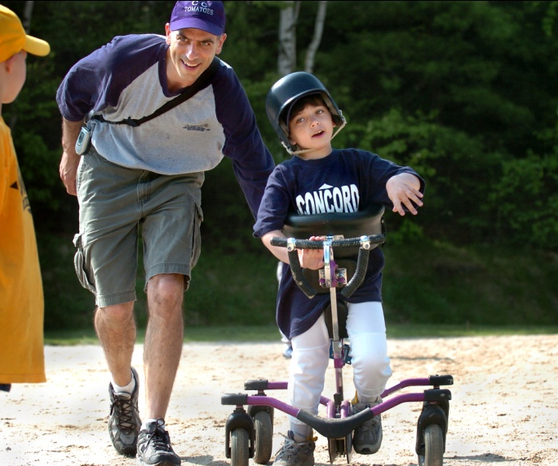
Welcome! The webinar will begin at 12:00 PM ET and end at approximately 1:30 PM ET.
Please use this moment to test your audio system. This slide includes music.
If you do not hear music, click on the "^" symbol next to your Audio Settings to select or test your preferred audio system.

Slide 2
Thanks for joining us!
Happy ADA Anniversary week!
We hope everyone is staying healthy and safe, and that the next 90 minutes can be an engaging and affirming gathering for the hundreds of people that are joining us today on Zoom and Facebook Live. The Zoom registration is closed, but you can invite others to watch on FB Live:
/instituteondisability

Slide 3
Today’s event is co-hosted by:

Slide 4
Captions
We will provide captions during the entire webinar.
To turn on captions, click "Closed Caption" in your meeting controls, and choose either “Show Subtitles” or “View Full Transcript” to select the view that works best for you.
Download the PowerPoint featured in today’s webinar, which contains alt text for images
https://tinyurl.com/DisabilityAndMedia
Live captioning and ASL interpreting supported by the
NH Bar Foundation Advancement of Justice Fund
Notes:
We will provide captions during the movie and discussion portion of the webinar.
To turn on captions, click ”Closed Caption” in your meeting controls and select either “Show Subtitles” or “View Full Transcript.”
Please note, when you open the transcript it may block portions of the chatroom panel.

Slide 5
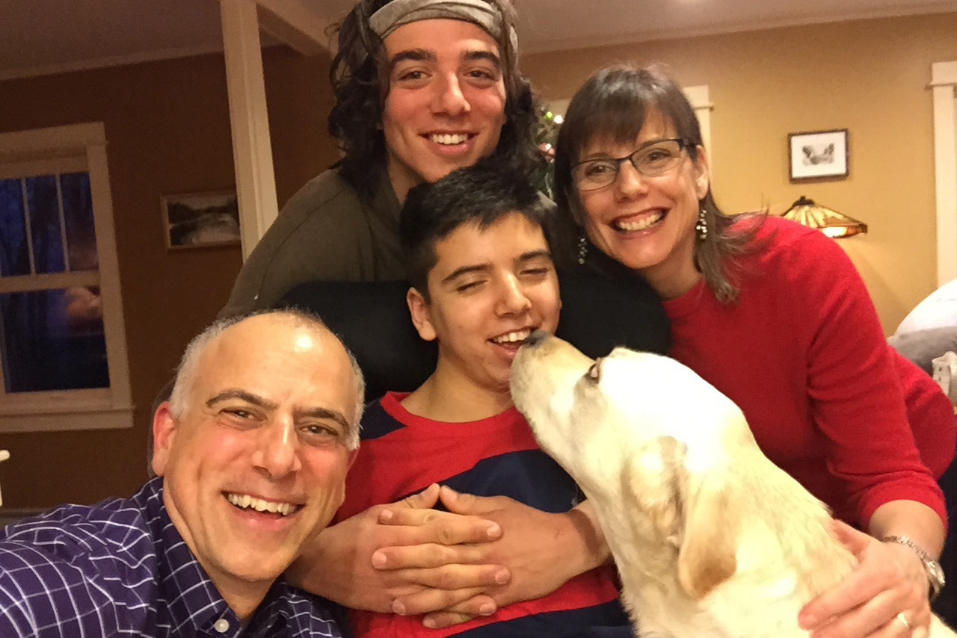
Dan Habib, moderator
Director and producer of:
Including Samuel (2008)
Who Cares About Kelsey? (2013)
Mr. Connolly Has ALS (2018)
Intelligent Lives (2019)
Filmmaker at the Institute on Disability at the University of New Hampshire and “Inclusive Communities” Project Director. 20 years as a journalist before joining the IOD.
Lives in Concord, NH, with wife Betsy McNamara and their son Samuel, 20, a college student, and his service dog, Proton. Their older son Isaiah, 23, lives in Flagstaff, AZ, and is a direct support worker for youth with emotional/behavioral disabilities.

Slide 6
Be social!
We encourage you to tweet/share the content of this webinar.
Use hashtags: #ADA30 #disabilitymedia
Tags:
@DRCNH @UNHIOD
@Imani_Barbarin FB: CrutchesandSpicebyImaniBarbarin
@Emily_ladau FB: WordsIWheelBy
@AndrewPulrang FB: Apulrang
@_danhabib FB: intelligentlives

Slide 7
Housekeeping
As an attendee of this webinar, you are a viewer. Webcams and microphones have been disabled for all participants.
If you have a question for our panel, please send it through the "Q&A" or “Chat” boxes at the bottom of your Zoom player during the webinar. We'll answer as many as we can.
Be sure to select “All Panelists and Attendees” if you want everyone attending the webinar to see your message.
Please remember that this is a family-friendly event.
Notes:
Before we begin, we have a few housekeeping items to cover about this webinar.
As an attendee of this webinar, you are a viewer. Webcams and microphones have been disabled for all participants.
Please remember that this is a family-friendly event.
If you have a question for our guests, please send it through the "Q&A" or “Chat” boxes at the bottom of your webinar player following the screening.

Slide 8
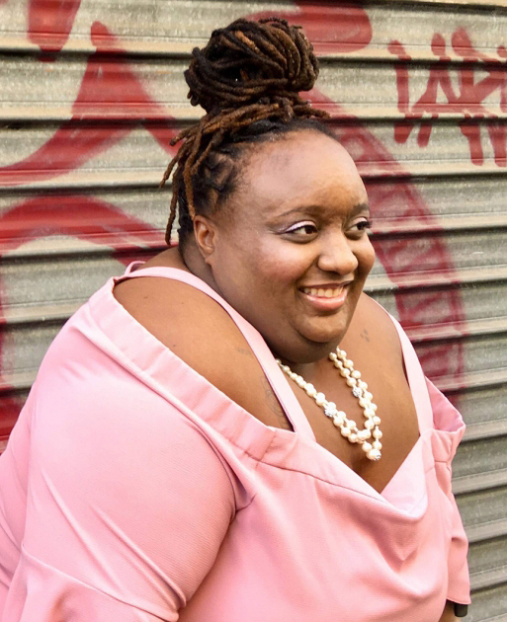
The Panelists
Imani Barbarin is a disability rights and inclusion activist and speaker who uses her voice and social media platforms to create conversations engaging the disability community.
Imani Barbarin

Slide 9
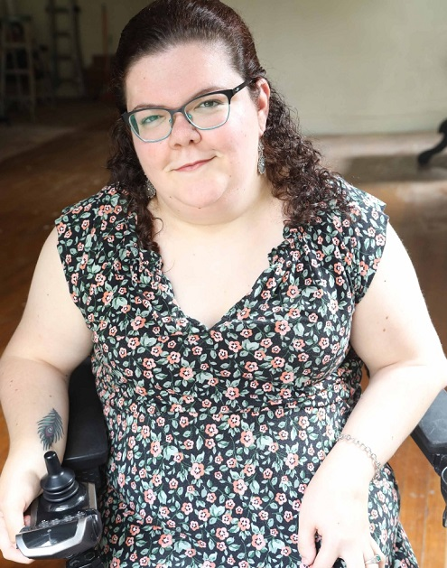
The Panelists
Emily Ladau is a disability rights activist, writer, speaker, and communications consultant.
Emily Ladau

Slide 10
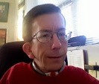
The Panelists
Andrew Pulrang is a freelance writer on disability, an online activist, and a former Center for Independent Living director.
Andrew Pulrang

Slide 11
“Disabled people in film, on television, and in other forms of media should reflect the reality of our lives. Our joys, sorrows, struggles, victories, and the everyday issues we all face. Only then will we be able to effectively counteract the themes of our being invisible or seen only as incapable, a drain, a tragedy.”
- Judith Heumann, from the Ford Foundation’s 2019 white paper
“Road Map for Inclusion: Changing the Face of Disability in Media”

Slide 12
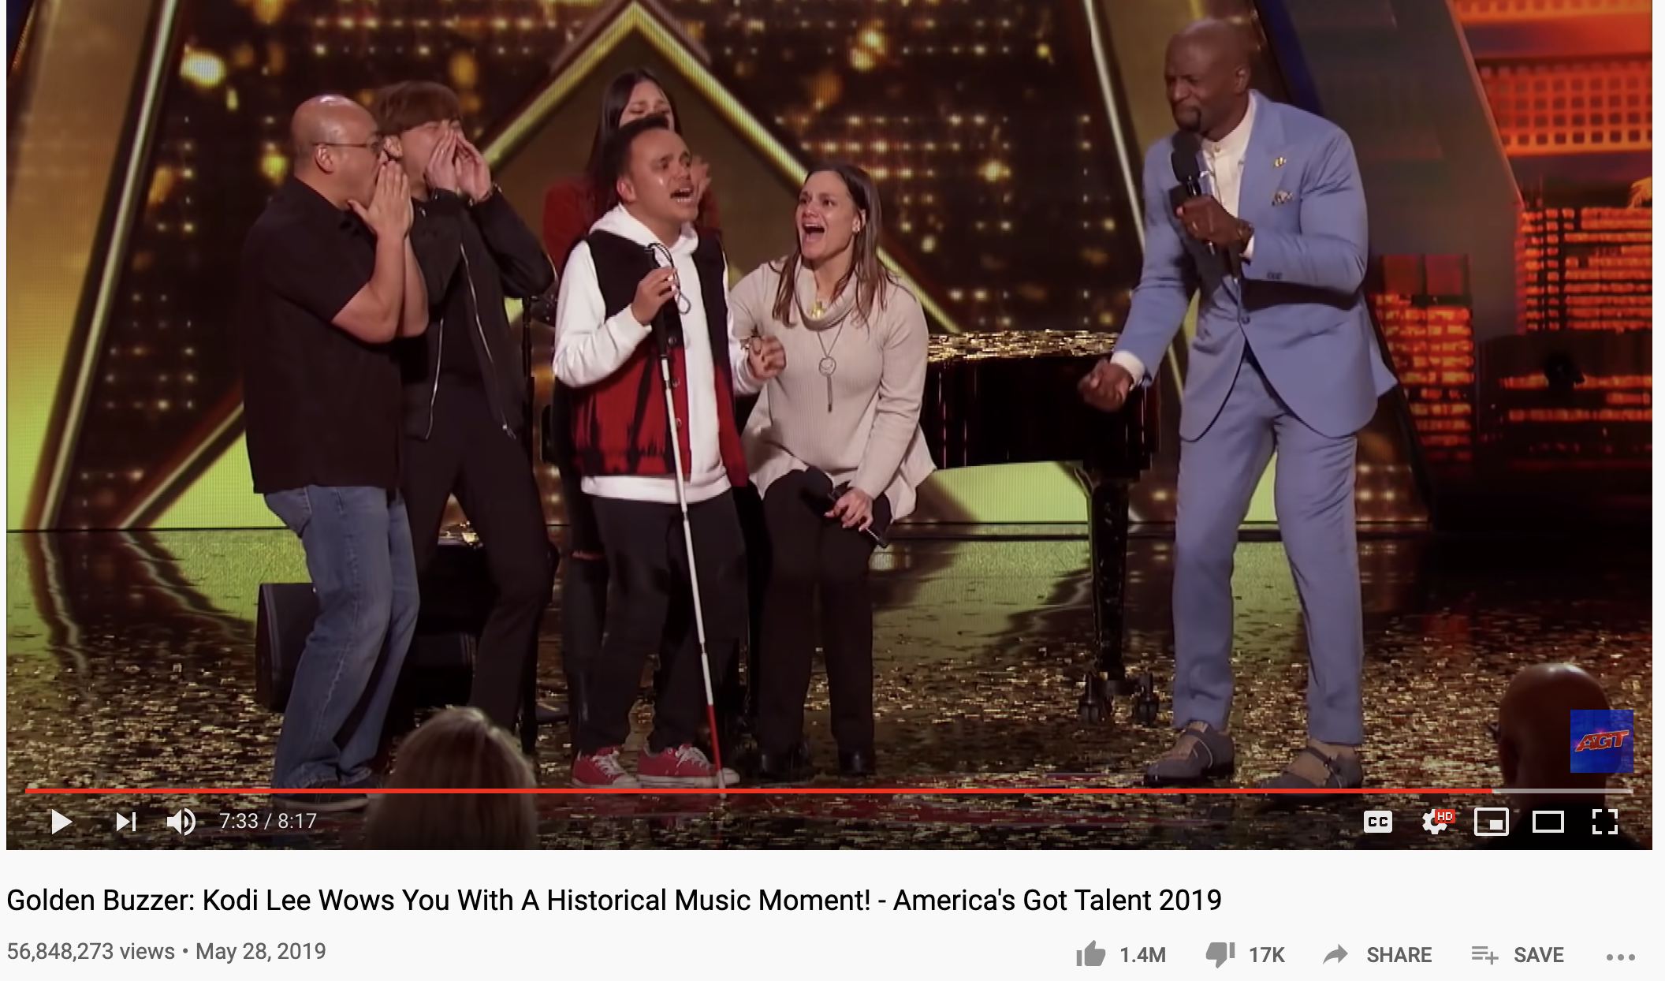
To get the conversation rolling…

Slide 13
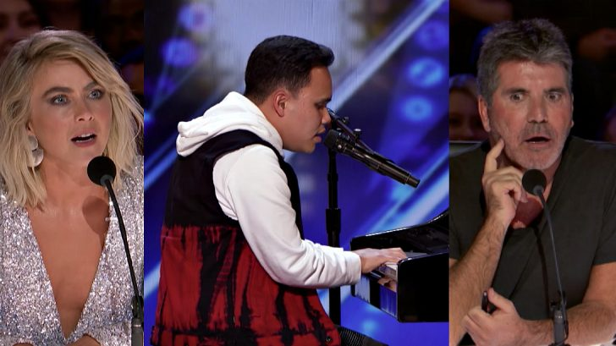
How does this AGT segment influence
perceptions about people with disabilities?

Slide 14
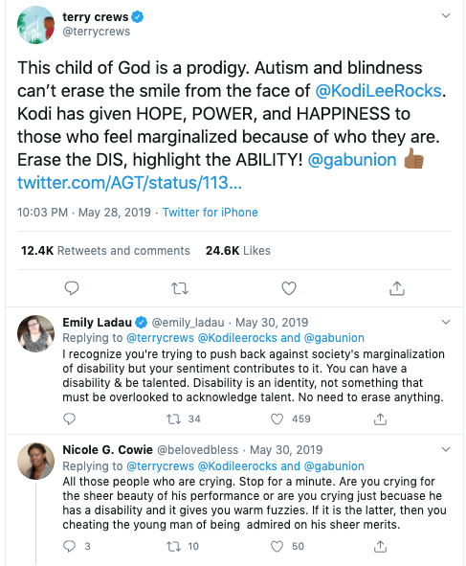
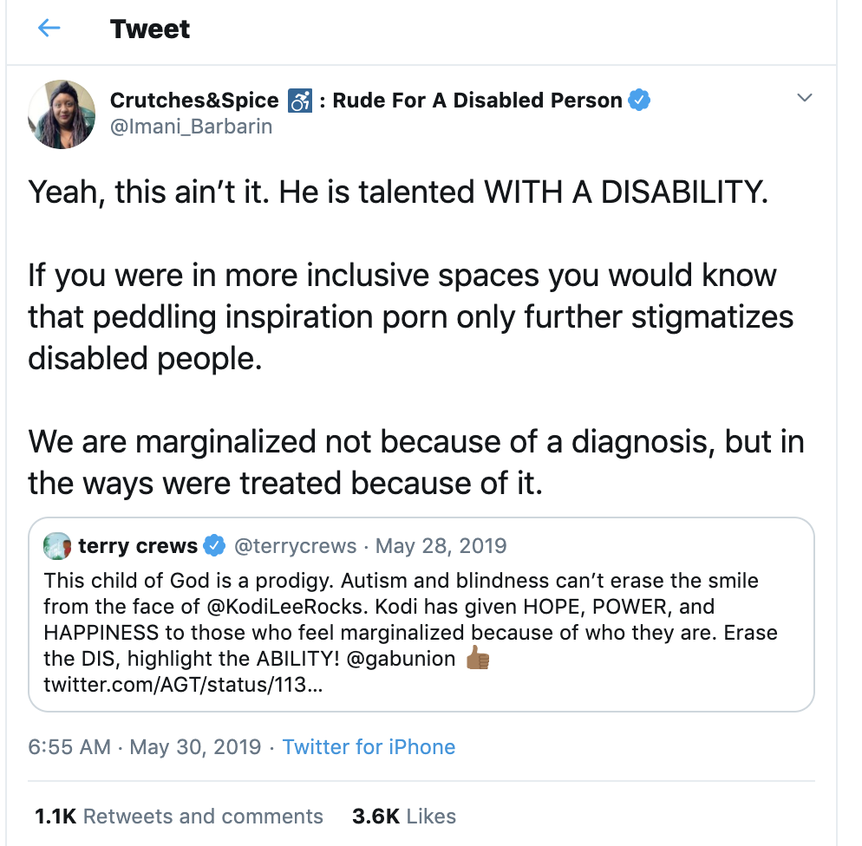

Slide 15
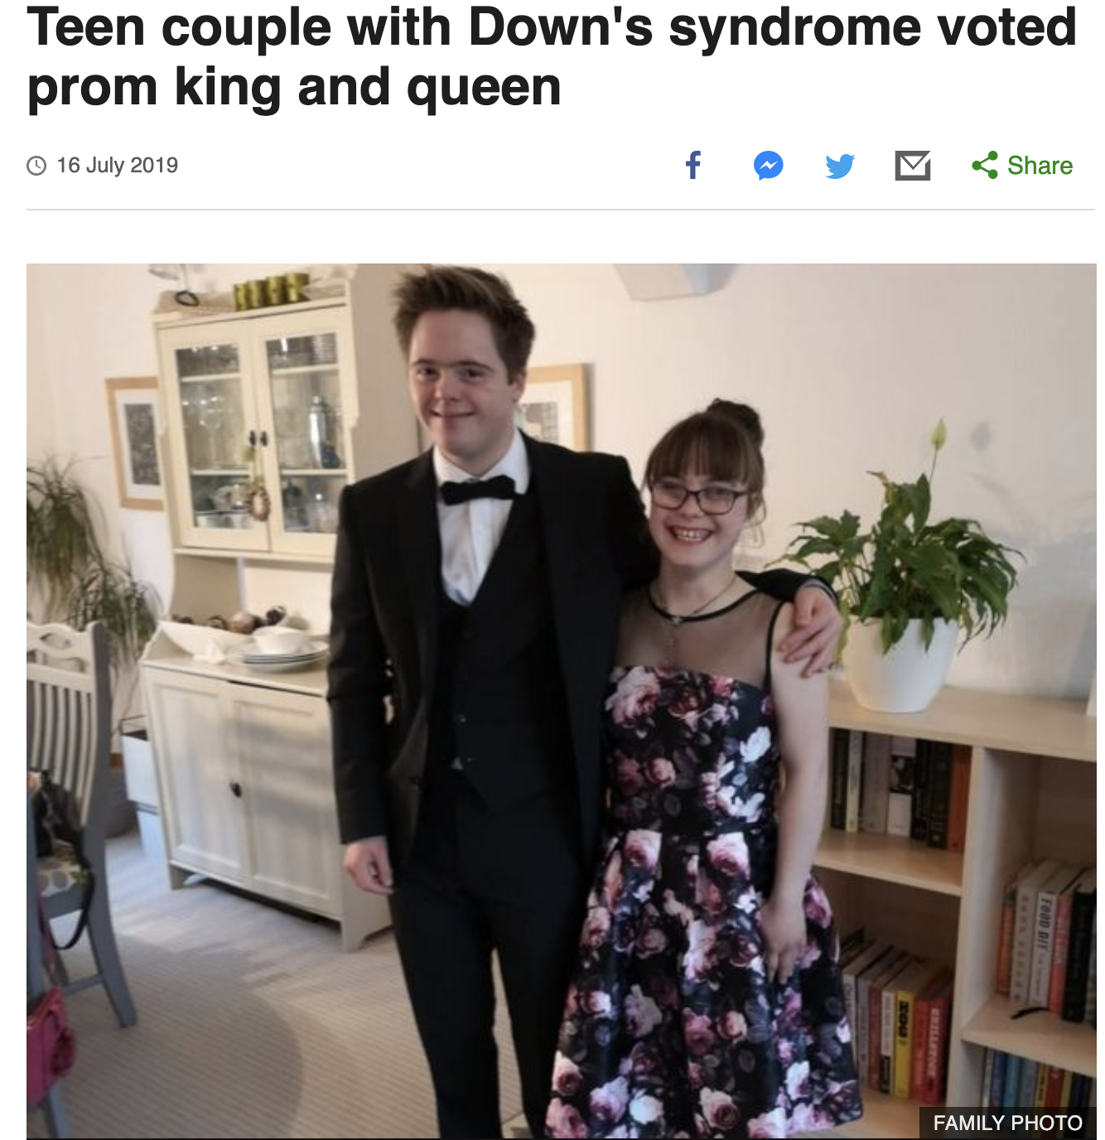
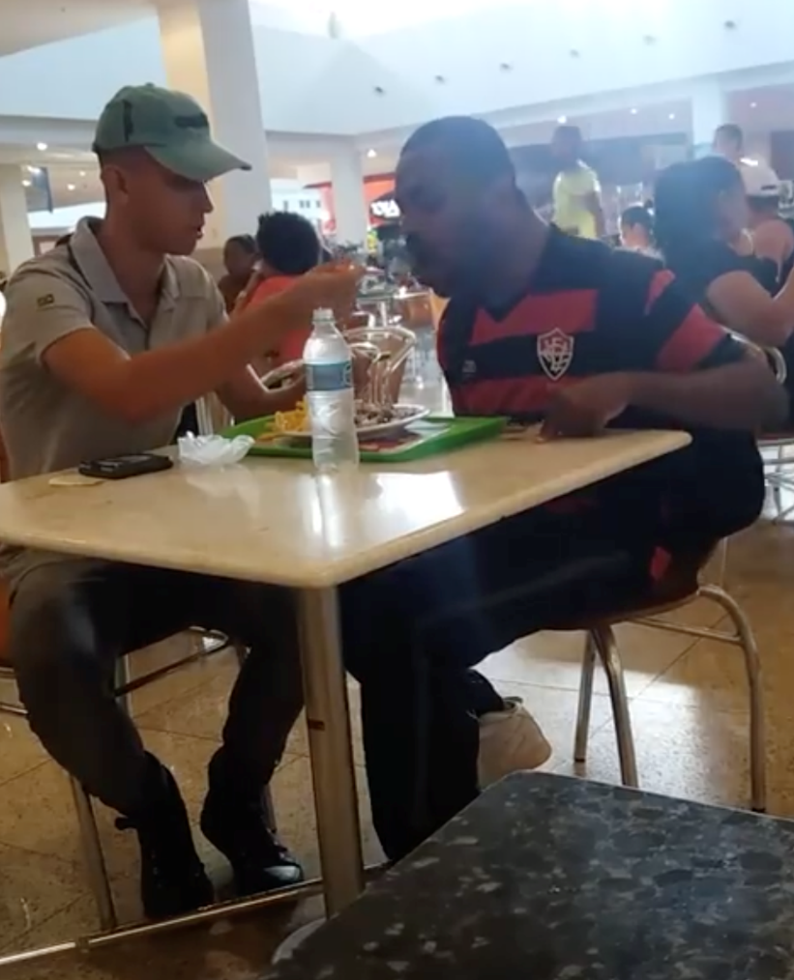
“Inspiration porn”

Slide 16
Framing media language around disability
Suffers from…
Special needs
Differently-Abled
Able-bodied
Crip
Wheelchair bound
Uses a wheelchair
Person with a disability
Disabled person

Slide 18
Disability portrayals
A recent Annenberg Inclusion Initiative study found that only 2.5 percent of film characters were depicted with a disability over the past 10 years, even though people with disabilities make up 25% of the U.S. population. And of those small numbers of characters, 95% were played by non-disabled actors.
Center for Disease Control. (2018, August 16). 1 in 4 US adults live with a disability [Press release]. https://www.cdc.gov/media/releases/2018/p0816-disability.html
Pieper, K. (2016, March 3). Disability. USC Annenberg School for Communication and Journalism. Retrieved from https://annenberg.usc.edu/research/annenberg-inclusion-initiative/research/disability.

Slide 19
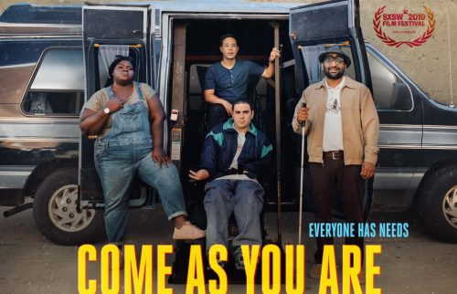

Slide 20
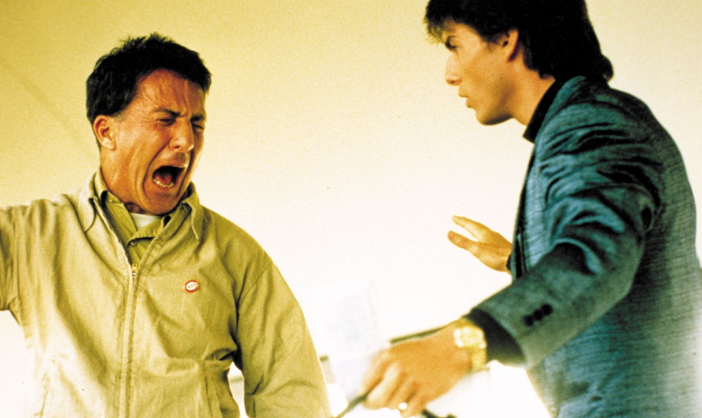
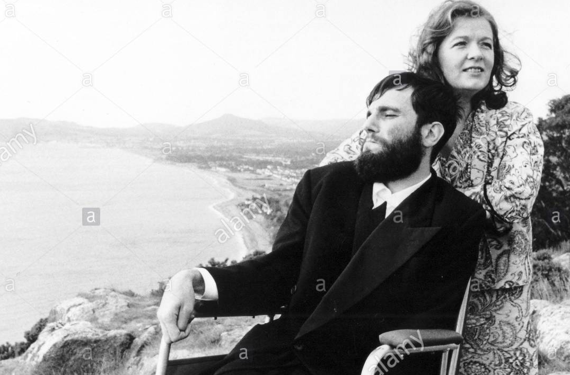
Non-disabled actors playing “super-crips,” “heroes,” and “villains”
I Am Sam, 2001 The Theory of Everything, 2014
Soloist, 2009
The Joker, 2019
Rainman, 1988
My Left Foot, 1989

Slide 21
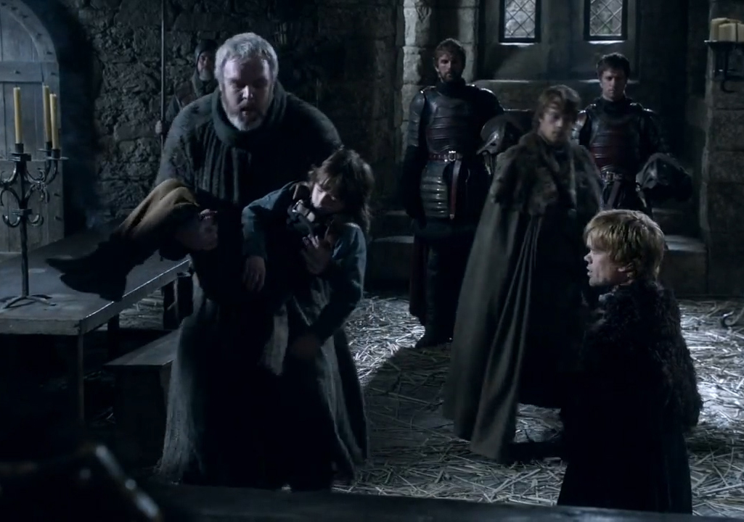
Authentic portrayals of disability – yes, there are some!
Game of Thrones

Slide 24
Speechless

Slide 25
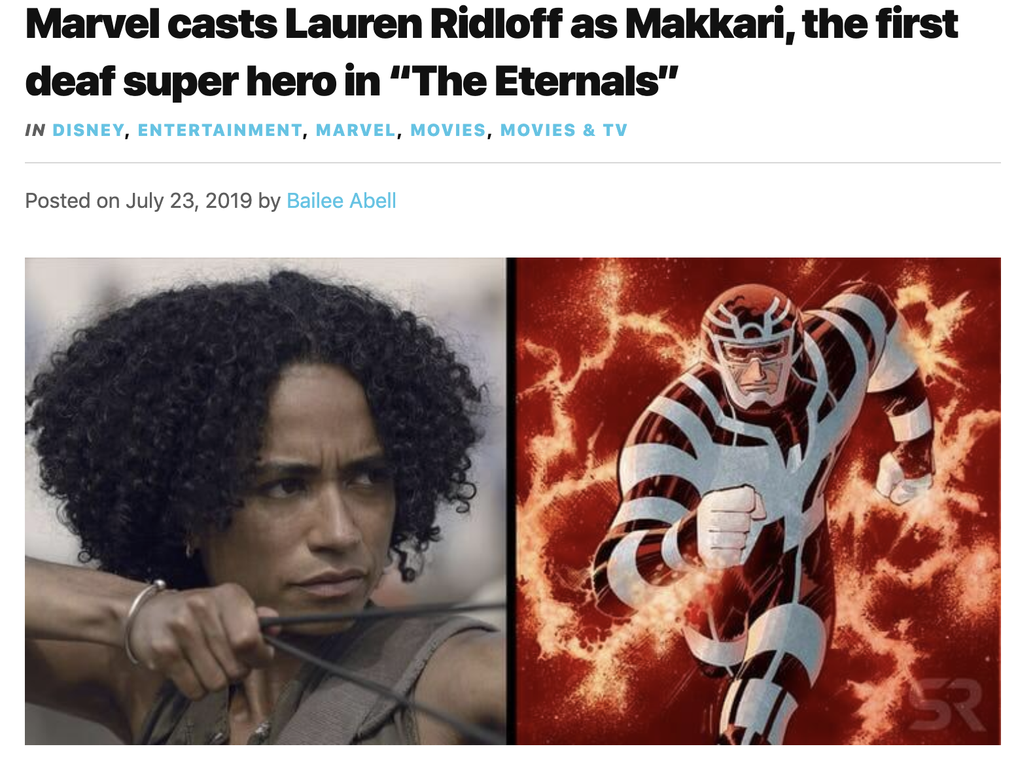
Why is disability in media so white?

Slide 26
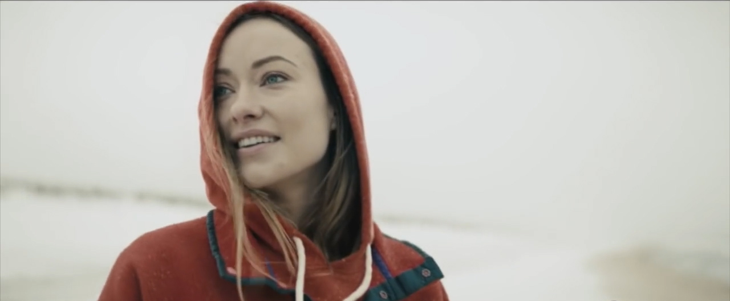
“Erasing” disability

Slide 27
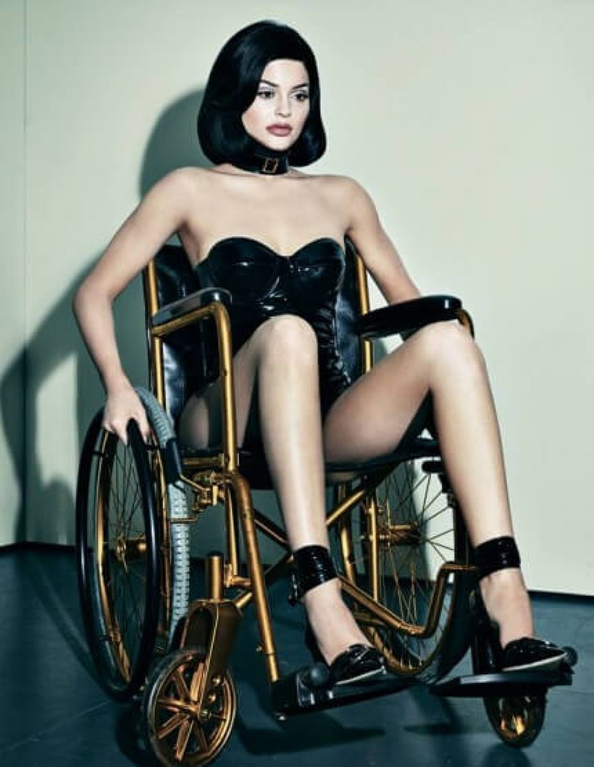
Appropriating
disability
Kylie Jenner in Interview Magazine

Slide 28
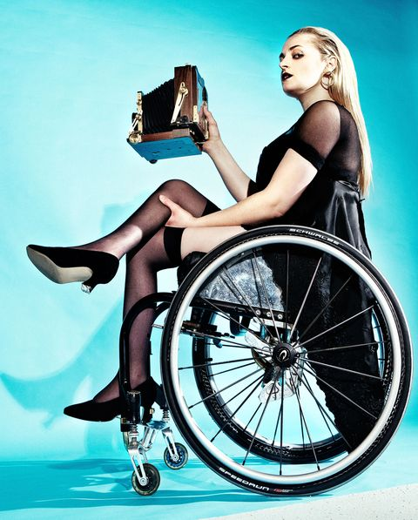
Ali Stroker
reclaims the image
“We are not putting people in black face anymore,” she said. “When we put them in a wheelchair, what is this saying?”
–Stroker, in Seventeen Magazine

Slide 29
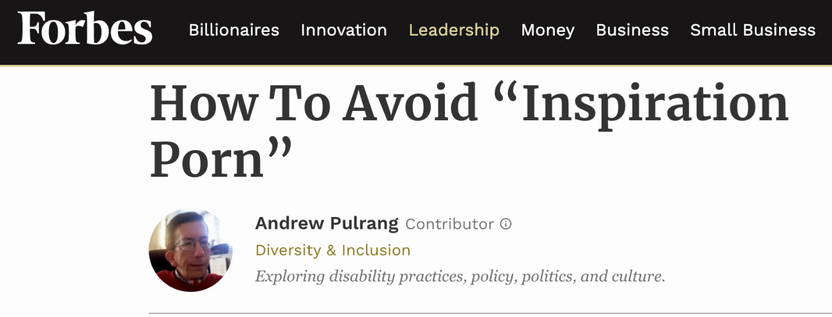
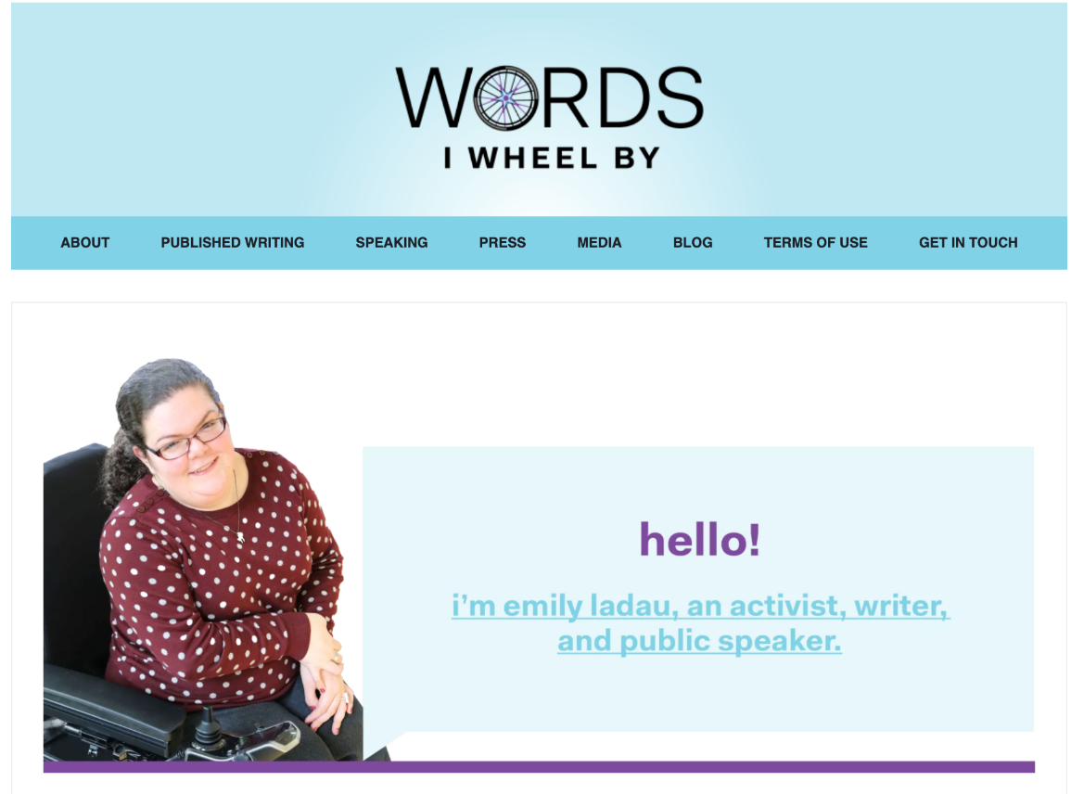
How do you work to frame the disability discourse through
social media?

Slide 30
What are your go-to resources?

Slide 31
Resources
Imani Barbarin:
CrutchesandSpice.com
Twitter: @Imani_Barbarin
Facebook: Facebook.com/CrutchesandSpice
Instagram: @Crutches_and_Spice
Emily Ladau:
Wordsiwheelby.com
Twitter: @emily_ladau
Instagram: @Emlad729
Andrew Pulrang:
Disabilitythinking.com
Twitter: @AndrewPulrang
Instagram: @Apulrang

Slide 32
Resources, cont’d.
Disability Rights Center – NH
drcnh.org
Institute on Disability – UNH
iod.unh.edu
Fordfoundation.org

